Slide 1

Tech Mentorship Unit 0
Set-Up GitHub & Replit

Slide 2
01
Set-Up Github

Slide 3
Purpose

Slide 4
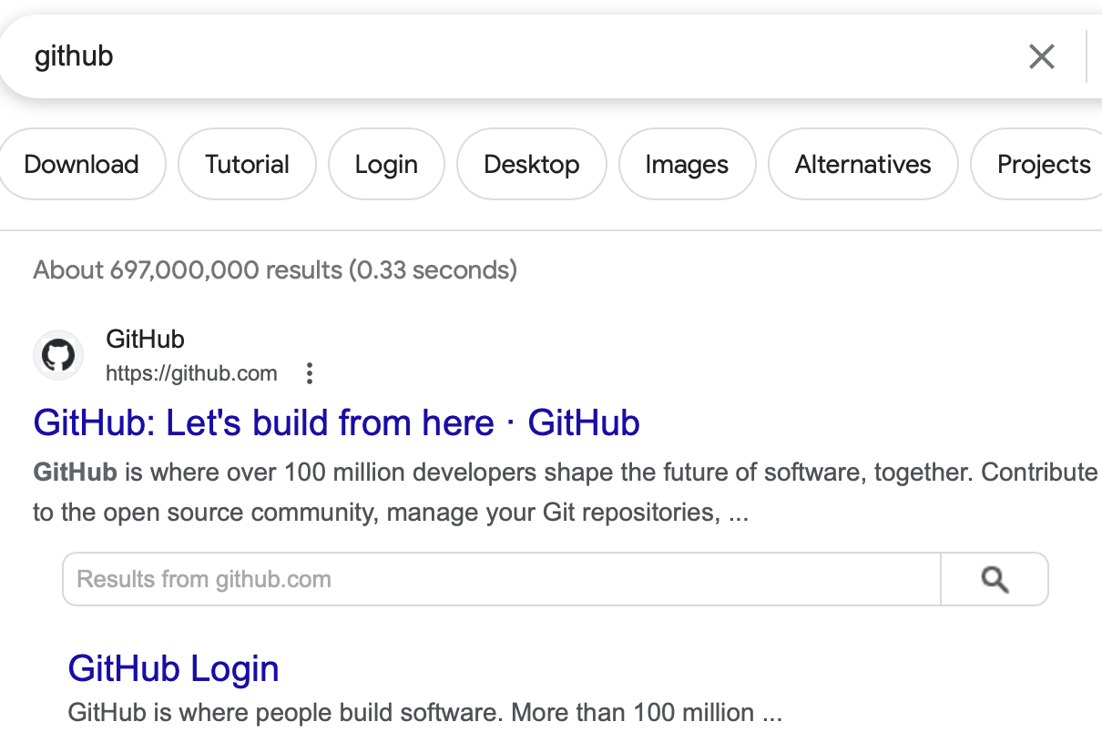
Step 1: Google “Github”
Click Here

Slide 5
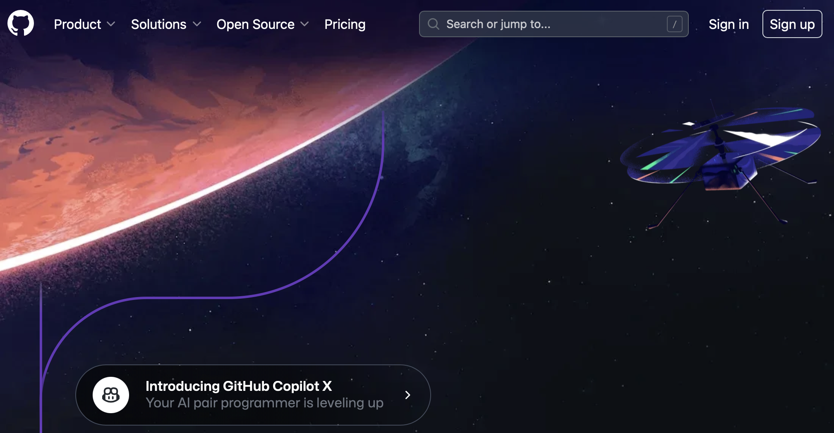
Step 2: Sign-Up
Click Here

Slide 6
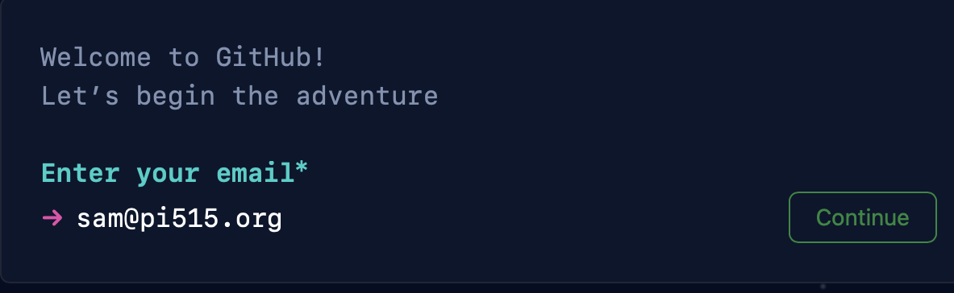
Step 3: Enter Email
Write Down Email on a Piece of Paper
Enter Email
Click to Continue

Slide 7
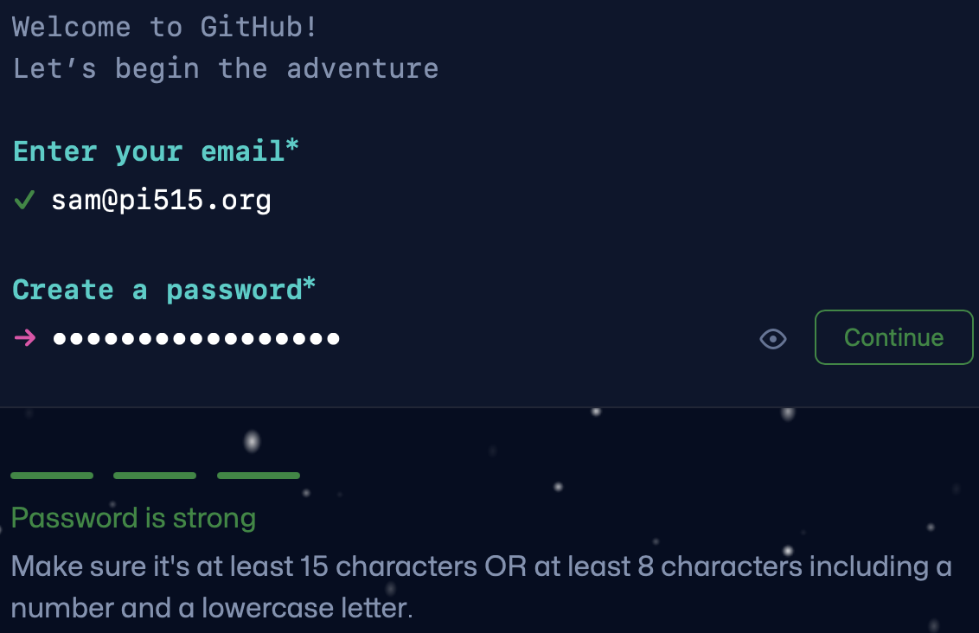
Step 4: Create Password
Write Down Password on Piece of Paper
Notes:
Please Make sure all students have written down their Email & Password

Slide 8
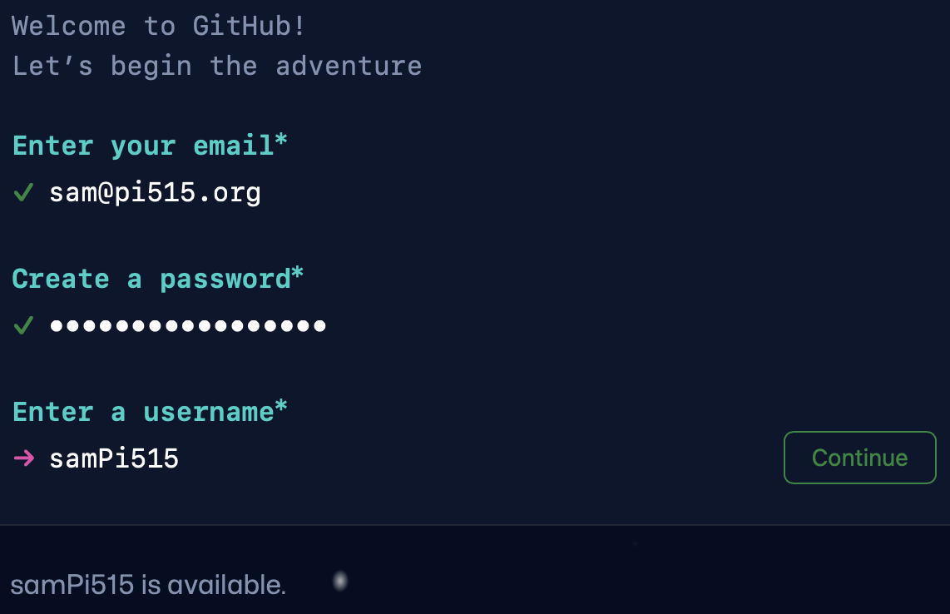
Step 5: Create Username
Write Down Username on Piece of Paper
Create Username
Click Here to Continue
Notes:
Make sure students also write down their username

Slide 9
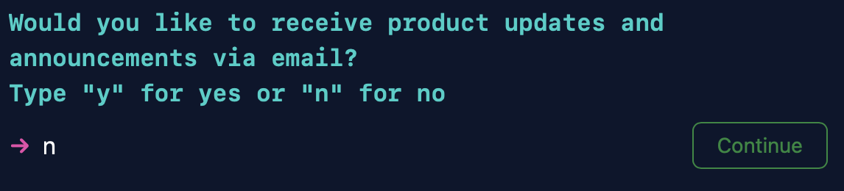
Step 6: Choice Preference

Slide 10
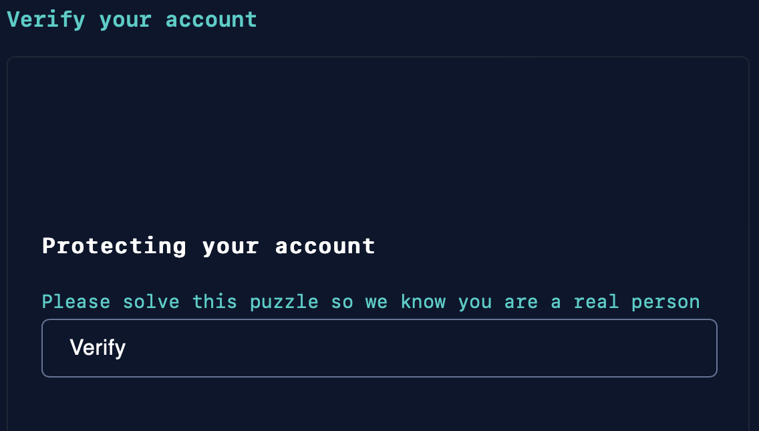
Step 7: Verify Account

Slide 11
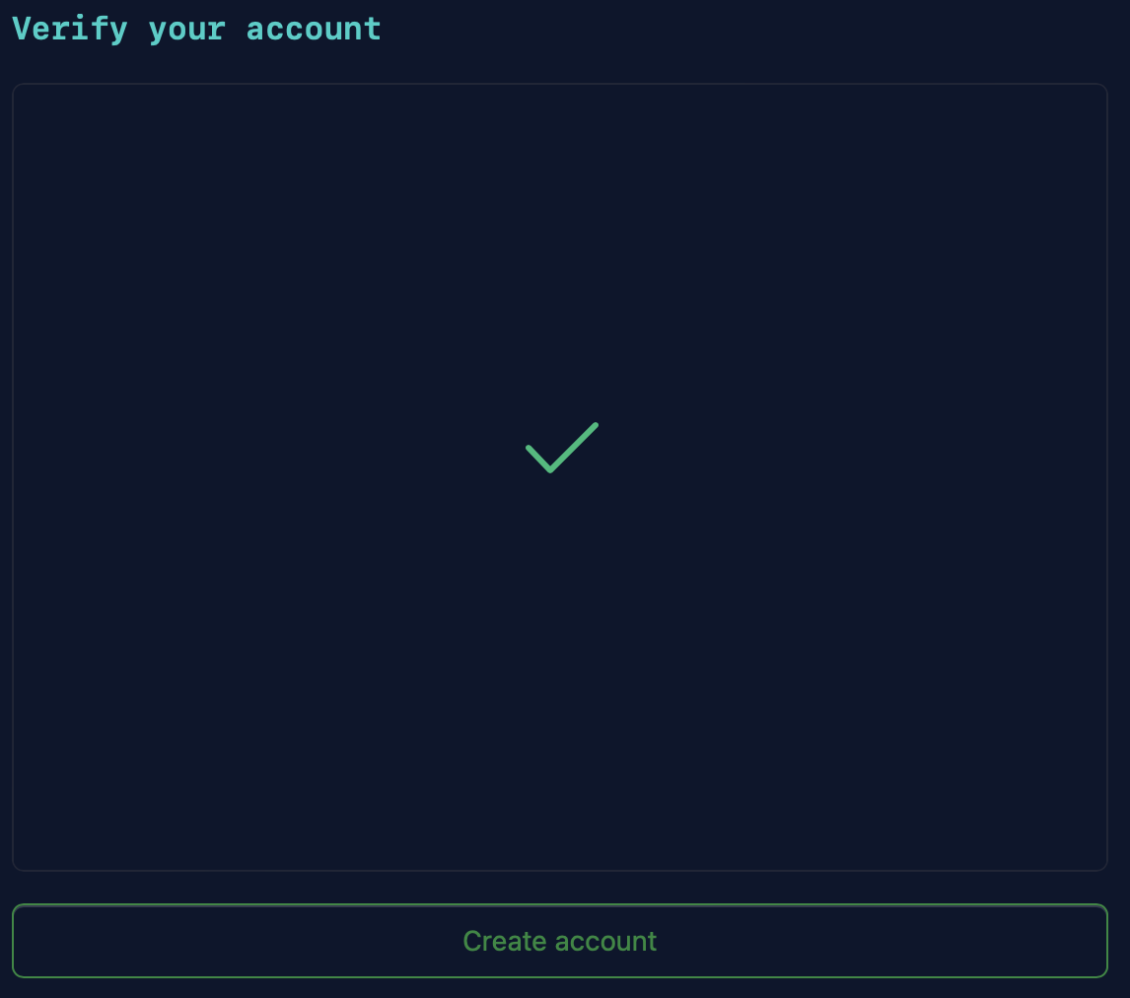
Step 7: Verify Account
Click Here

Slide 12
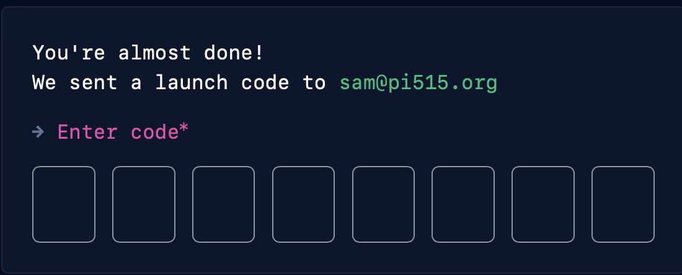
Step 8: Verification Code
Click Here
Enter 6 Digit Verification Code Here
Notes:
If students cannot find their 6-digit code in their Email ask them to check their spam folder

Slide 13
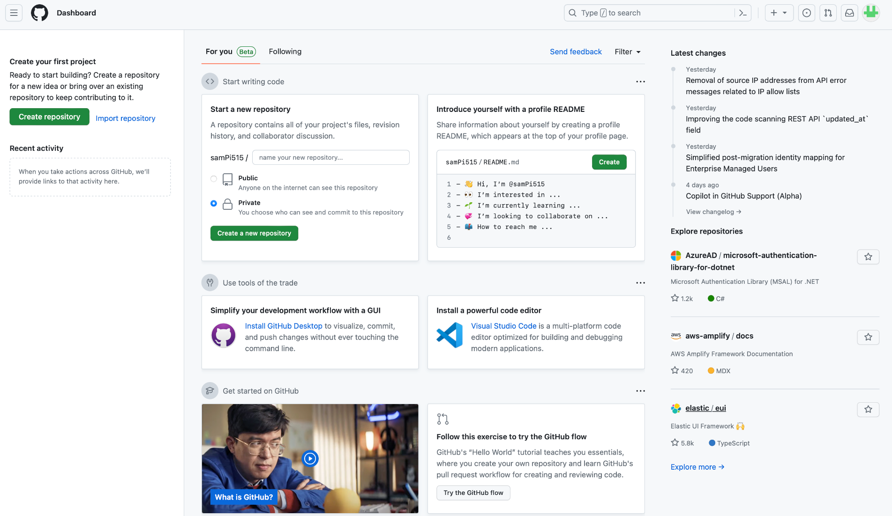

Step 9: Hooray, You Made IT!
Click Here
Notes:
If students cannot find their 6-digit code in their Email ask them to check their spam folder

Slide 14
GitHub Login Information
Please Write Down your…
Email
Password
Username
Share it with a Pi515 member
Notes:
If students cannot find their 6-digit code in their Email ask them to check their spam folder

Slide 15
02
Set-Up Replit

Slide 16
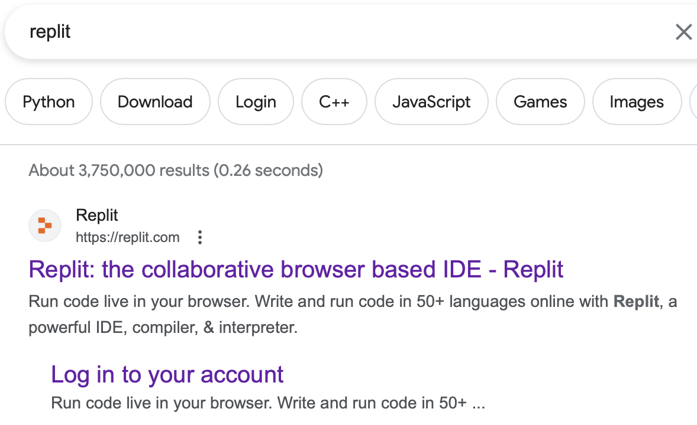
Step 1: Google “Replit”
Click Here

Slide 17
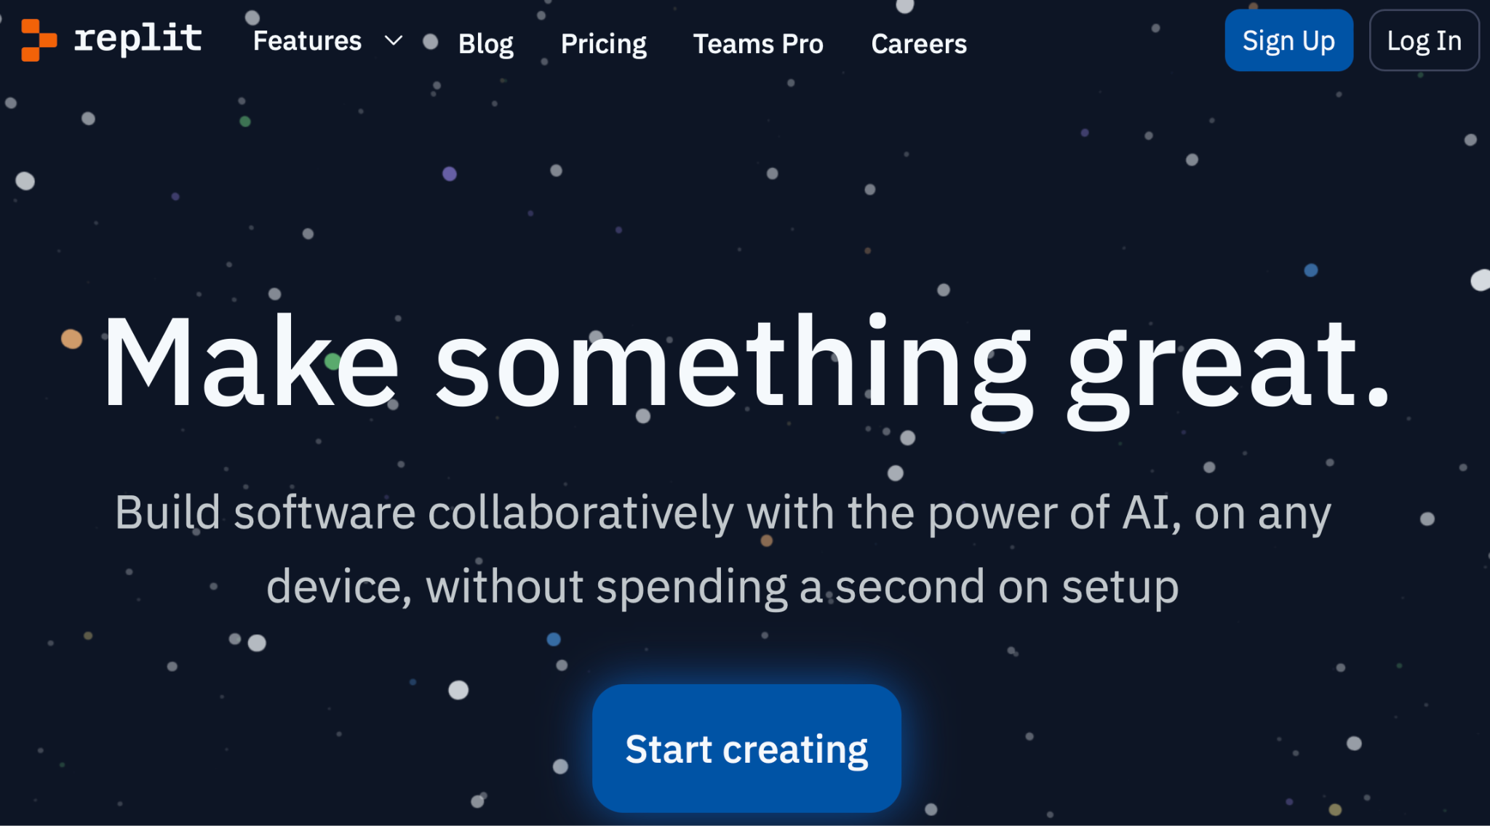
Step 2: Sign Up
Click Here

Slide 18
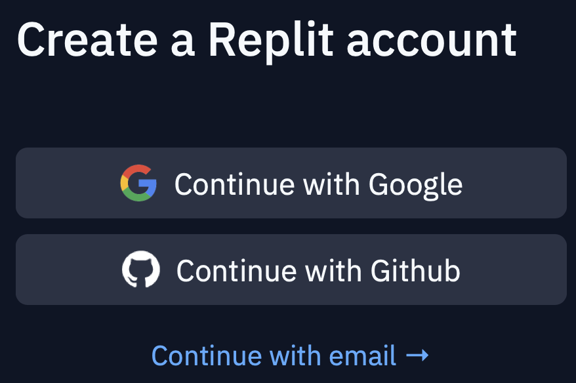
Step 3: Continue w/Github
Click Here

Slide 19
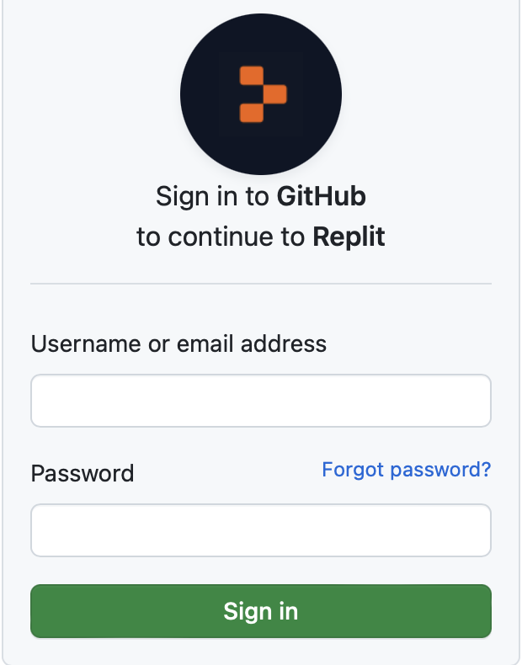
Step 4:
Login w/ GitHub Info
Enter GitHub
Login Information
and Click “Sign In”

Slide 20
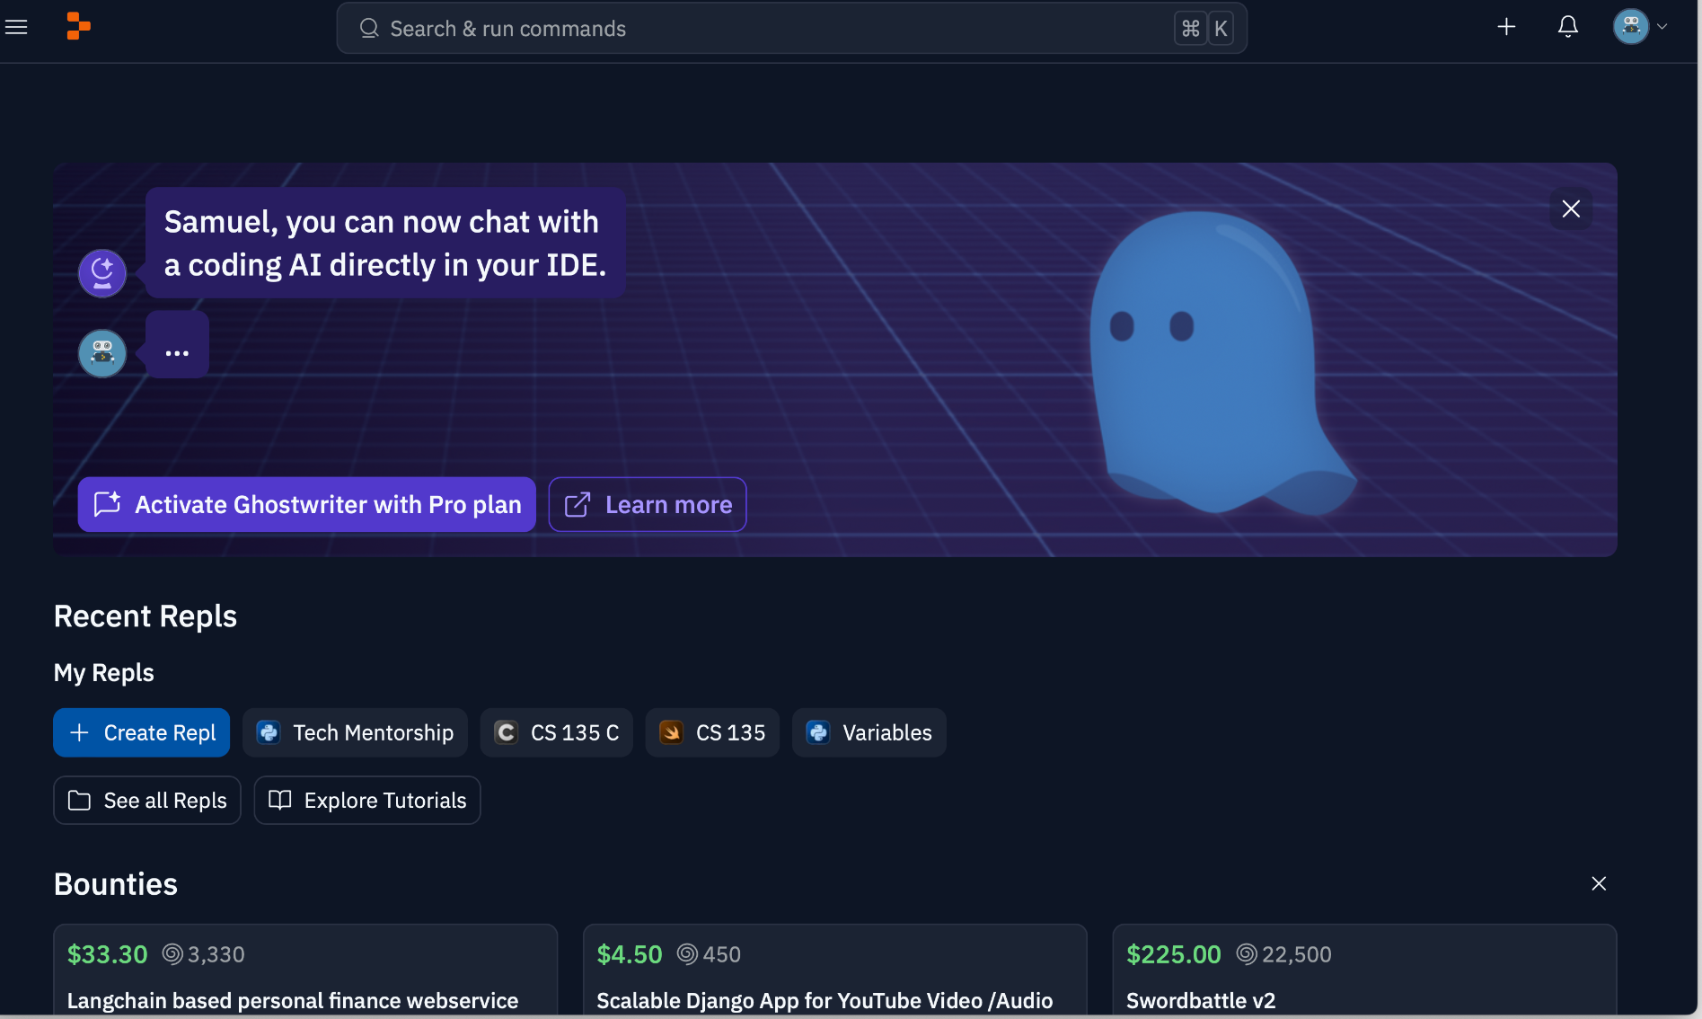
Step 5: Hooray, You Made IT!
Notes:
Instructors please make sure all students successfully log into Replit

